Slide 1

Biological Databases: Theories and Practice
430032
Intermediate and Advanced SQL
Instructor: Prof. LEE, Tzong-Yi (李宗夷)
Email: leetzongyi@nycu.edu.ctw
Professor
Institute of Bioinformatics and Systems Biology,
National Yang Ming Chiao Tung University
结合传统与现代
融会中国与西方

Slide 2
Outline
Join Expressions
Accessing SQL From a Programming Language
JDBC and ODBC
Embedded SQL
OLAP
Notes:
1

Slide 3
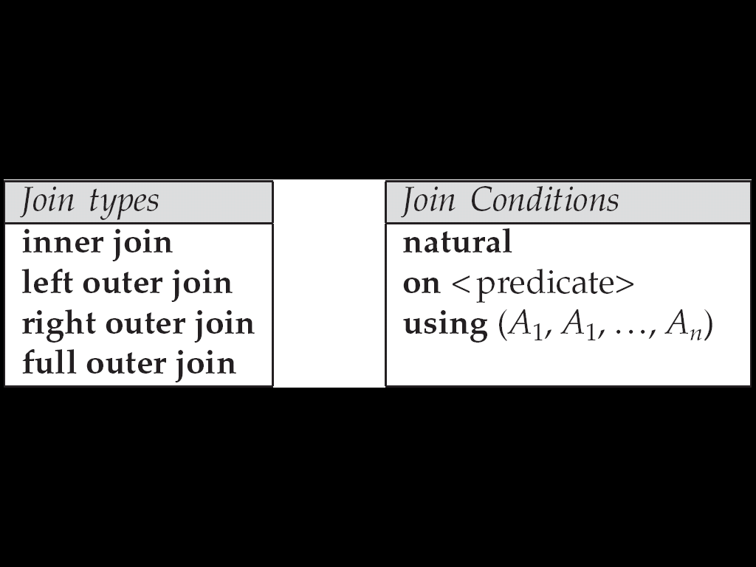
Joined Relations
Join operations take two relations and return as a result another relation.
These additional operations are typically used as subquery expressions in the from clause
Join condition – defines which tuples in the two relations match, and what attributes are present in the result of the join.
Join type – defines how tuples in each relation that do not match any tuple in the other relation (based on the join condition) are treated.

Slide 4
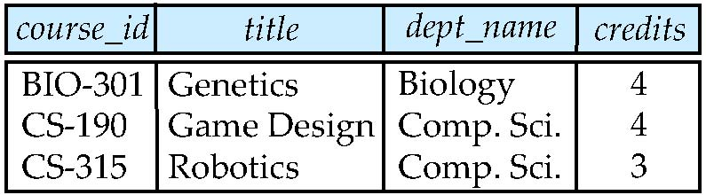
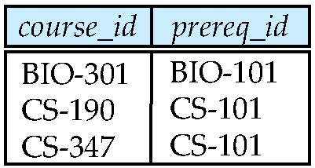
Join operations – Example
Relation course
Relation prereq
Note: prereq information missing for CS-315 and course information missing for CS-347.

Slide 5
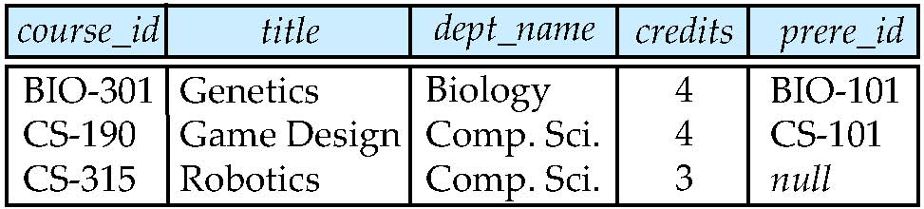
Left Outer Join
select * from course natural left outer join prereq
Note: read prere_id as prereq_id
course
prereq

Slide 6
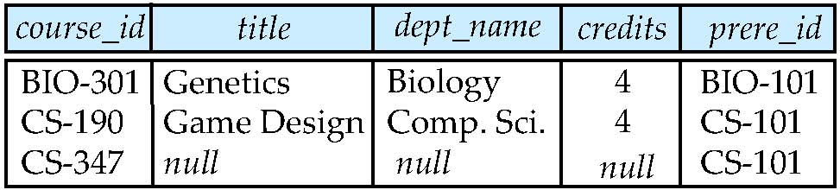
Right Outer Join
select * from course natural right outer join prereq
course
prereq

Slide 7
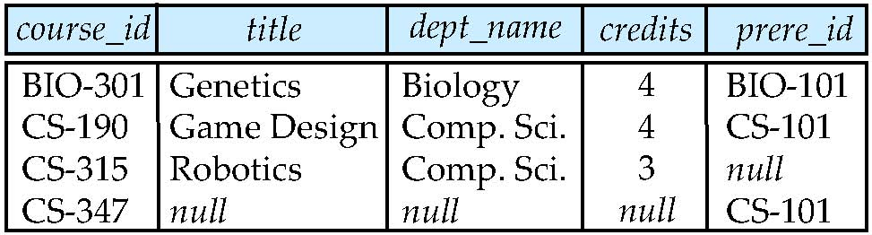
Full Outer Join
select * from course natural full outer join prereq
course
prereq

Slide 8
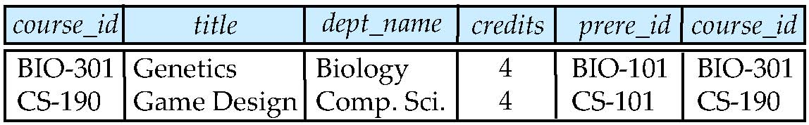
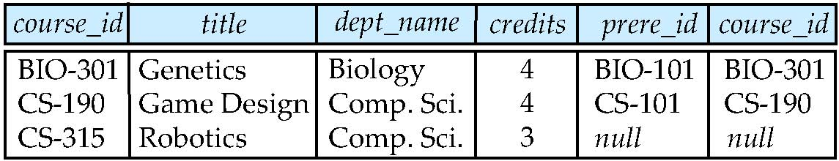
Joined Relations – Examples
Select * from course inner join prereq on course.course_id = prereq.course_id
Select * from course left outer join prereq on course.course_id = prereq.course_id

Slide 9
Joined Relations – Examples
Select * from course natural right outer join prereq
Select * from course full outer join prereq using (course_id)

Slide 10
JDBC and ODBC
API (application-program interface) for a program to interact with a database server
Application makes calls to
Connect with the database server
Send SQL commands to the database server
Fetch tuples of result one-by-one into program variables
ODBC (Open Database Connectivity) works with C, C++, C#, and Visual Basic
Other API’s such as ADO.NET sit on top of ODBC
JDBC (Java Database Connectivity) works with Java

Slide 11
JDBC
JDBC is a Java API for communicating with database systems supporting SQL.
JDBC supports a variety of features for querying and updating data, and for retrieving query results.
JDBC also supports metadata retrieval, such as querying about relations present in the database and the names and types of relation attributes.
Model for communicating with the database:
Open a connection
Create a “statement” object
Execute queries using the Statement object to send queries and fetch results
Exception mechanism to handle errors

Slide 12
JDBC Code
public static void JDBCexample(String dbname, String userid, String passwd)
{
try {
Class.forName ("oracle.jdbc.driver.OracleDriver");
Connection conn = DriverManager.getConnection( "jdbc:oracle:thin:@cuhk.edu.cn:2000:”.dbname, userid, passwd);
Statement stmt = conn.createStatement();
… Do Actual Work ….
stmt.close();
conn.close();
}
catch (SQLException sqle) {
System.out.println("SQLException : " + sqle);
}
}

Slide 13
JDBC Code (Cont.)
Update to database
try { stmt.executeUpdate("insert into instructor values(’77987’, ’Kim’, ’Physics’, 98000)"); } catch (SQLException sqle)
{ System.out.println("Could not insert tuple. " + sqle); }
Execute query and fetch and print results
ResultSet rset = stmt.executeQuery( "select dept_name, avg (salary) from instructor group by dept_name"); while (rset.next()) { System.out.println(rset.getString("dept_name") + " " + rset.getFloat(2)); }

Slide 14
PHP program connecting to MySQL
Example:
<?php
mysqli_report(MYSQLI_REPORT_ERROR | MYSQLI_REPORT_STRICT);
$link = mysqli_connect("localhost", "student", "student", "Practice");
$query = "SELECT * from instructor";
$result = mysqli_query($link,"SELECT * from instructor");
while ($row = mysqli_fetch_row($result))
{
echo "ID =".$row[0]."<br>\n";
}
mysqli_close($mysqli);
?>

Slide 15
Prepared Statement
PreparedStatement pStmt = conn.prepareStatement( "insert into instructor values(?,?,?,?)"); pStmt.setString(1, "88877"); pStmt.setString(2, "Perry"); pStmt.setString(3, "Finance"); pStmt.setInt(4, 125000); pStmt.executeUpdate(); pStmt.setString(1, "88878"); pStmt.executeUpdate();
WARNING: always use prepared statements when taking an input from the user and adding it to a query
NEVER create a query by concatenating strings
“ insert into instructor values(’ ” + ID + “ ’, ’ ” + name + “ ’, ’ ” + dept_name + “ ’, ” + balance + “ ) ”
What if name is “D’Souza”?

Slide 16
SQL Injection
Suppose query is constructed using
"select * from instructor where name = ’" + name + "’"
Suppose the user, instead of entering a name, enters:
X’ or ’Y’ = ’Y
then the resulting statement becomes:
"select * from instructor where name = ’" + "X’ or ’Y’ = ’Y" + "’"
which is:
select * from instructor where name = ’X’ or ’Y’ = ’Y’
User could have even used
X’; update instructor set salary = salary + 10000; --
Prepared statement internally uses: "select * from instructor where name = ’X\’ or \’Y\’ = \’Y’
Always use prepared statements, with user inputs as parameters

Slide 17
Data Analysis and OLAP
Online Analytical Processing (OLAP)
Interactive analysis of data, allowing data to be summarized and viewed in different ways in an online fashion (with negligible delay)
Data that can be modeled as dimension attributes and measure attributes are called multidimensional data.
Measure attributes
measure some value
can be aggregated upon
e.g., the attribute quantity of the sales relation
Dimension attributes
define the dimensions on which measure attributes (or aggregates thereof) are viewed
e.g., the attributes item_name, color, and size of the sales relation

Slide 18
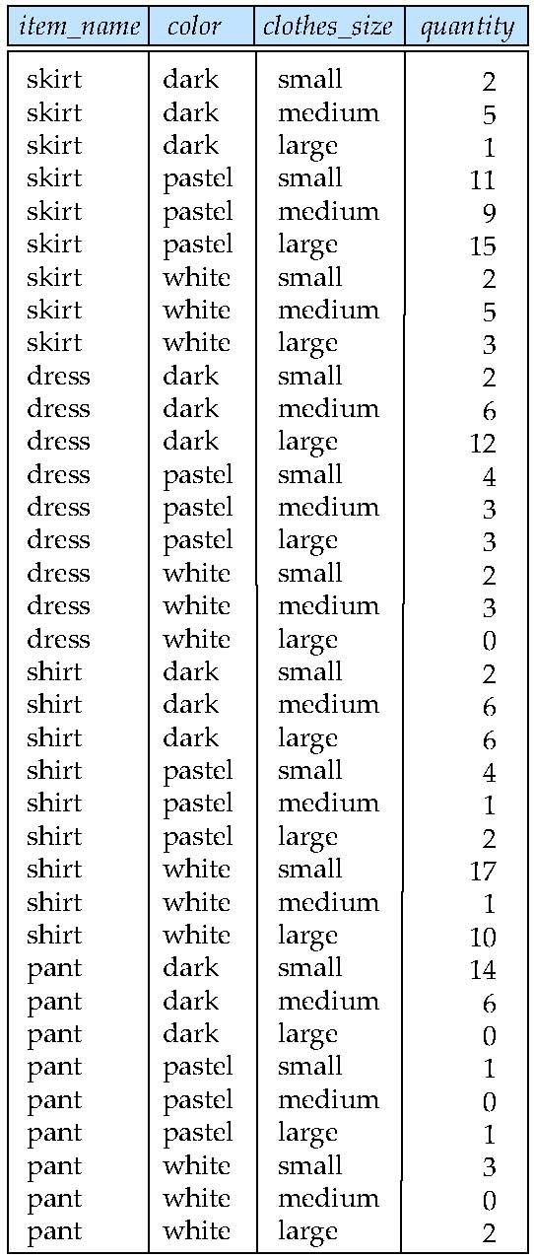
Example sales relation
Measure attributes
Dimension attributes

Slide 19
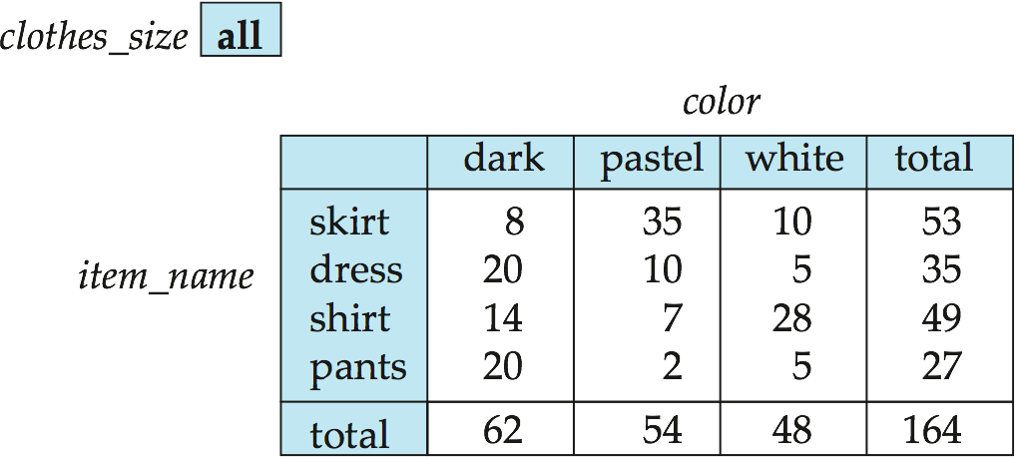
Cross Tabulation of sales by item_name and color
The table above is an example of a cross-tabulation (cross-tab), also referred to as a pivot-table.
Values for one of the dimension attributes form the row headers
Values for another dimension attribute form the column headers
Other dimension attributes are listed on top
Values in individual cells are (aggregates of) the values of the dimension attributes that specify the cell.

Slide 20
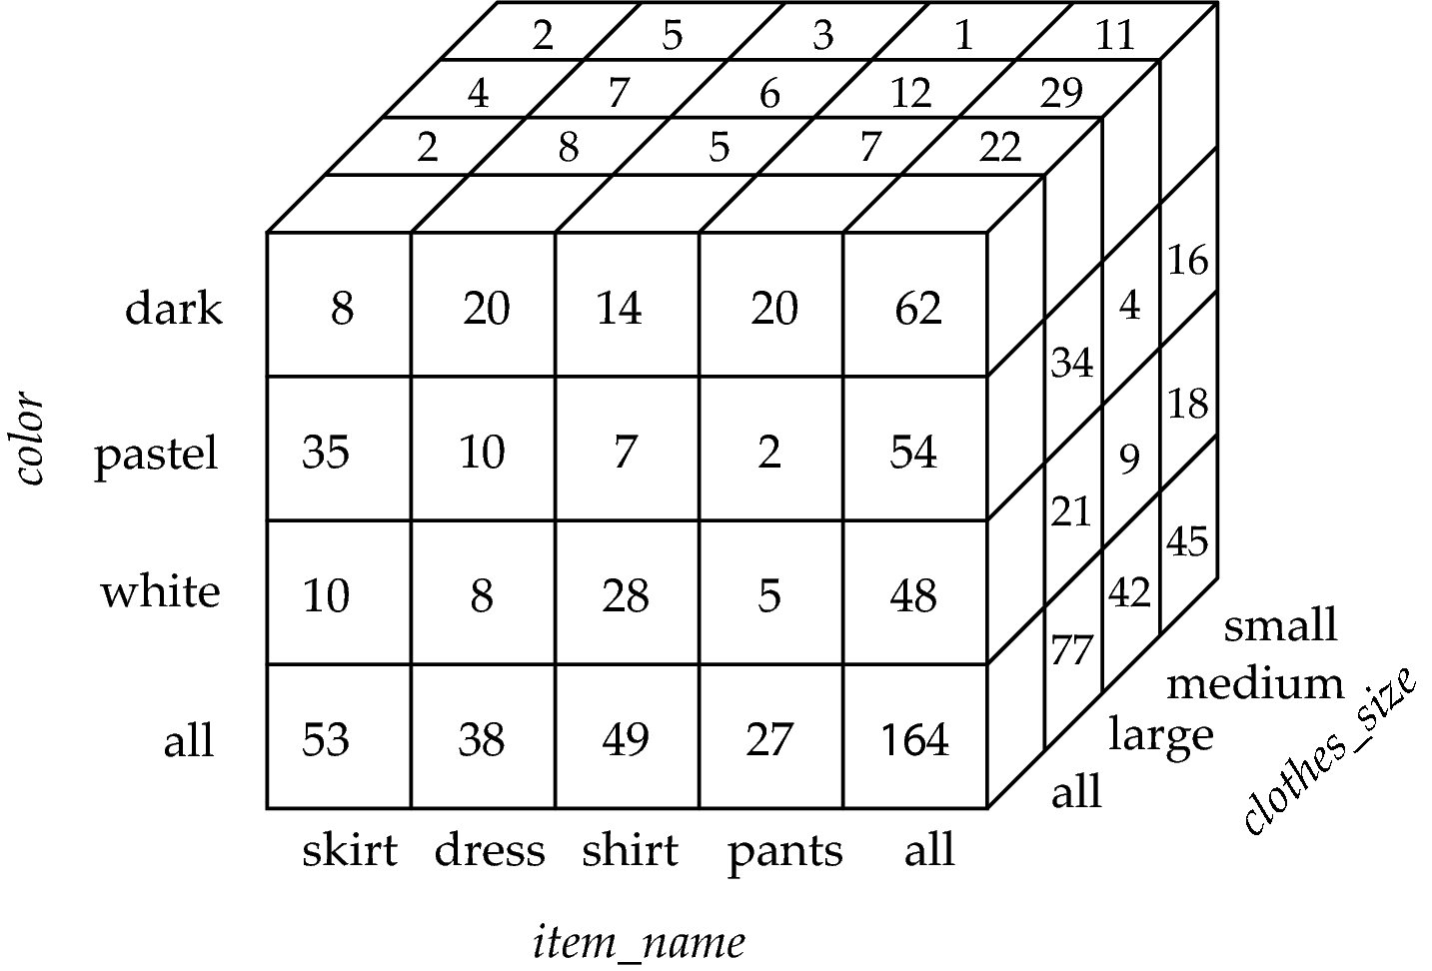
Data Cube
A data cube is a multidimensional generalization of a cross-tab
Can have n dimensions; we show 3 below
Cross-tabs can be used as views on a data cube

Slide 21
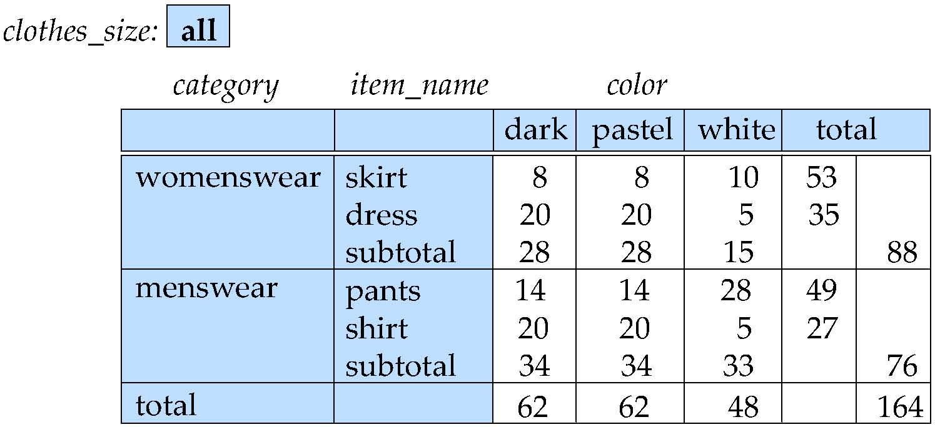
Cross Tabulation With Hierarchy
Cross-tabs can be easily extended to deal with hierarchies
Can drill down or roll up on a hierarchy

Slide 22
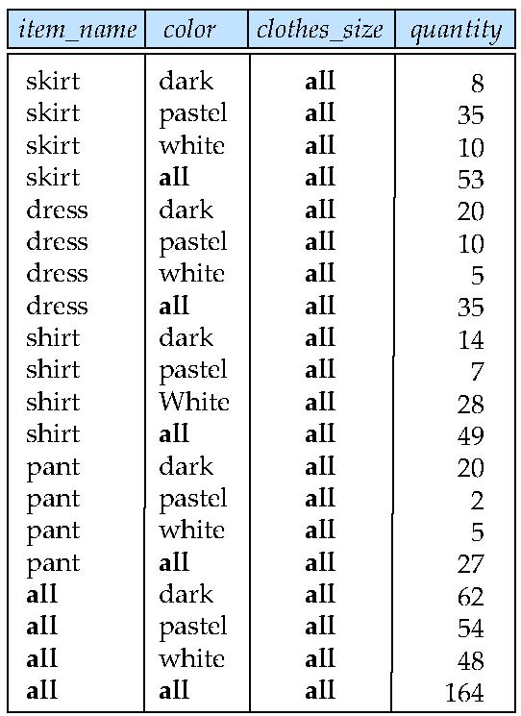
Relational Representation of Cross-tabs
Cross-tabs can be represented as relations
The value all is used to represent aggregates.
The SQL standard actually uses null values in place of all despite confusion with regular null values.

Slide 23
Extended Aggregation to Support OLAP
The cube operation computes union of group by’s on every subset of the specified attributes
Example relation for this section sales(item_name, color, clothes_size, quantity)
E.g. consider the query
select item_name, color, clothes_size, sum(quantity) from sales group by cube(item_name, color, clothes_size)
This computes the union of eight different groupings of the sales relation:
{ (item_name, color, clothes_size),
(item_name, color), (item_name, clothes_size), (color, clothes_size), (item_name), (color), (clothes_size),
( ) }
where ( ) denotes an empty group by list.
For each grouping, the result contains the null value for attributes not present in the grouping.

Slide 24
Extended Aggregation
Relational representation of cross-tab that we saw earlier,
but with null in place of all, can be computed by
select item_name, color, sum(quantity) from sales group by cube(item_name, color)
The function grouping() can be applied on an attribute
Returns 1 if the value is a null value representing all,
and returns 0 in all other cases.
select item_name, color, clothes_size, sum(quantity), grouping(item_name) as item_name_flag, grouping(color) as color_flag, grouping(clothes_size) as size_flag, from sales group by cube(item_name, color, clothes_size)
Can use the function decode() in the select clause to replace such nulls by a value such as all
E.g., replace item_name in first query by decode( grouping(item_name), 1, ‘all’, item_name)

Slide 25

Thank you and
any questions?

